Slide 1



Web programming
Term project
You Quiz?
On the Gachon
201835491 이소은
201937913 박예진
202031439 최동현
202135522 김재우

Slide 2


INDEX
01
Title
02
Description (DEMO)
03
Modeling
04
Key Feature
05
Implementation Details
06
Expected Effects
07
Information & Duties Division
Web programming
Team project (Group E)

Slide 3

01 Title
You Quiz?
On the Gachon
Web page for academic development of Gachon University students
study theory, review what you have learned through quizes, and develop yourself further.
Web programming
Team project (Group E)

Slide 4




01 Title
Motivation to create
1. Study easily
2. Check my status
3. Provide Information
Improving an individual's ability
Web programming
Team project (Group E)

Slide 5
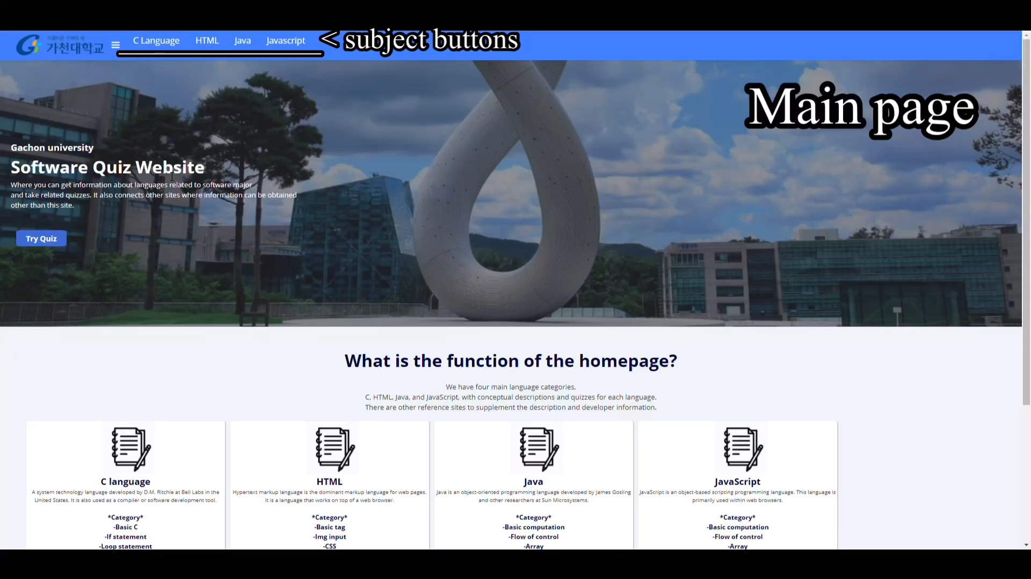
02 DEMO
Web programming
Team project (Group E)

Slide 6
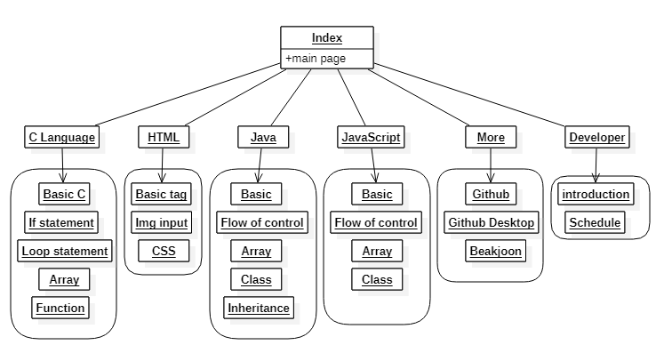
03 Modeling
Architecture
Web programming
Team project (Group E)

Slide 7
03 Modeling
Architecture
Web programming
Team project (Group E)

Slide 8
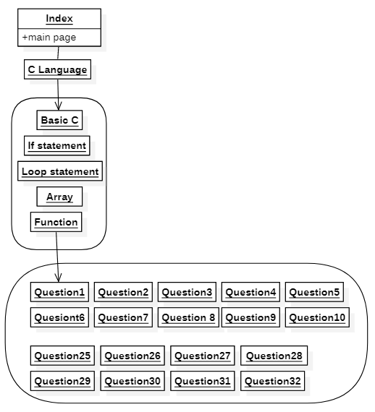
03 Modeling
Architecture
All problem pages have 20~30 sub-problems.
As result, our website consists of 460 files and 43 folders.
Web programming
Team project (Group E)

Slide 9

03 Modeling
Skills
Html
CSS
JavaScript
JQuery
Web programming
Team project (Group E)

Slide 10




04 Key feature
Knowldege acquision
Study
Melticulous study
Test
Web programming
Team project (Group E)
Notes:
특징
지식 습득이 가능하다 → 이론을 배우고, 퀴즈로 확실히 기억할 수 있다.
세분화 되어있다 → 여러
확장 가능성 → 다른 코딩을 공부하는데 필요한 정보들을 담고 있어, 지식을 얻는데 무한한 확장성을 가지고 있다.

Slide 11

04 Key feature
segmentation
HTML
C
JavaScript
Java
Segmentation
Web programming
Team project (Group E)
Notes:
특징
지식 습득이 가능하다 → 이론을 배우고, 퀴즈로 확실히 기억할 수 있다.
세분화 되어있다 → 여러
확장 가능성 → 다른 코딩을 공부하는데 필요한 정보들을 담고 있어, 지식을 얻는데 무한한 확장성을 가지고 있다.

Slide 12




04 Key feature
Practical tips
Scalability
Web programming
Team project (Group E)
Notes:
특징
지식 습득이 가능하다 → 이론을 배우고, 퀴즈로 확실히 기억할 수 있다.
세분화 되어있다 → 여러
확장 가능성 → 다른 코딩을 공부하는데 필요한 정보들을 담고 있어, 지식을 얻는데 무한한 확장성을 가지고 있다.

Slide 13
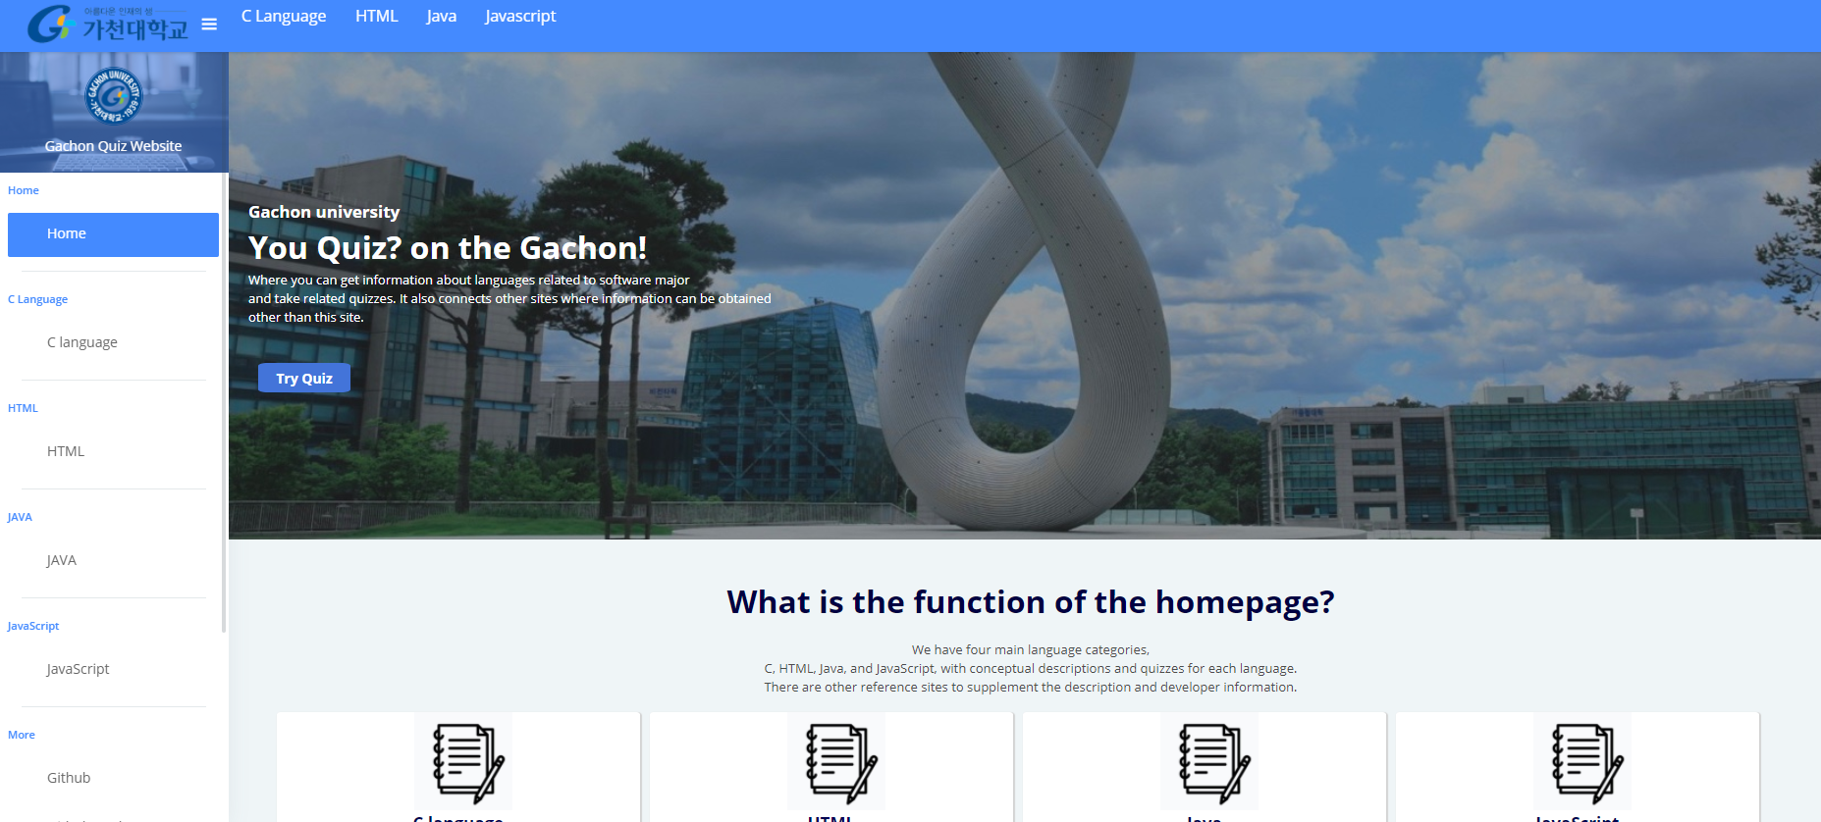
05 Implementation Details
<main page>
Put a picture of Gachon University, indirectly indicating that it is a web page for our school students.
Web programming
Team project (Group E)
Notes:
HTML, JS, CSS 3가지로 나누어서 설명하겠다.

Slide 14
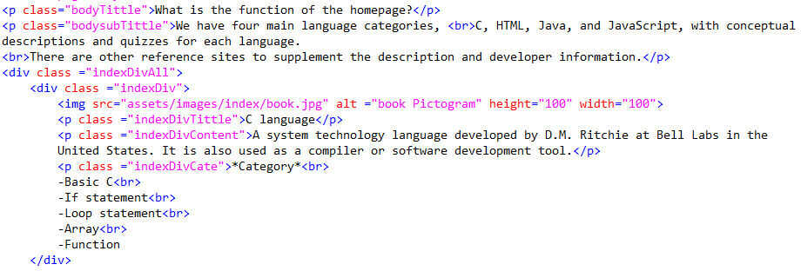

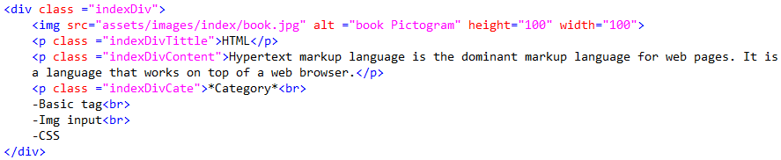
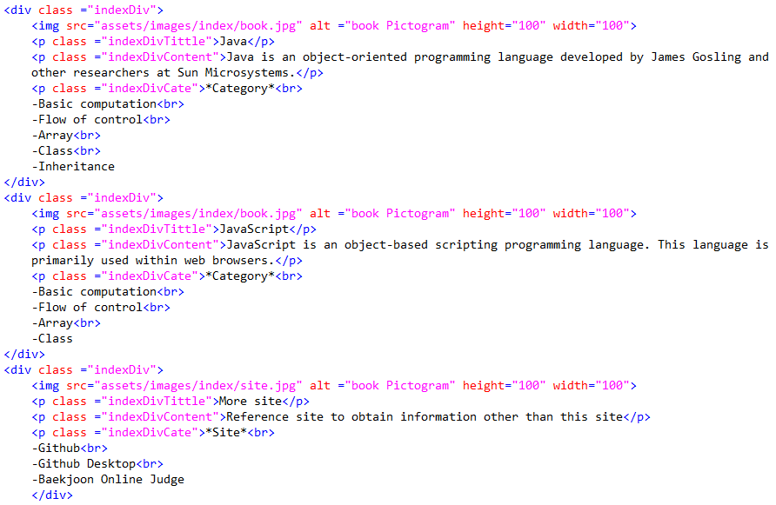
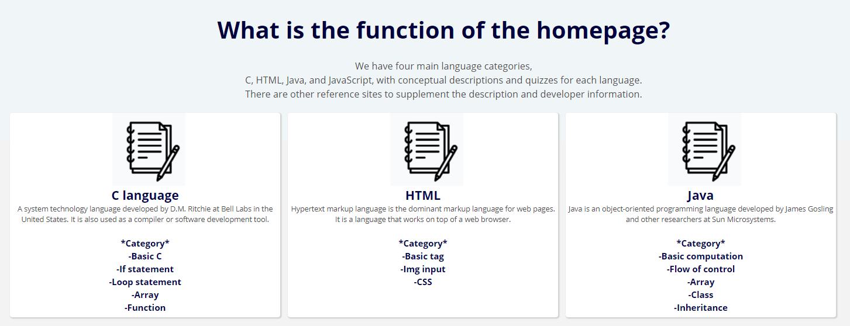
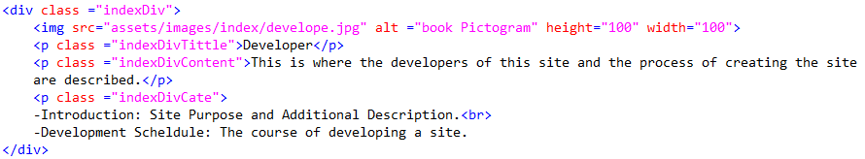
05 Implementation Details
<main page>
Button that move to quiz page
Web programming
Team project (Group E)
Notes:
HTML, JS, CSS 3가지로 나누어서 설명하겠다.

Slide 15
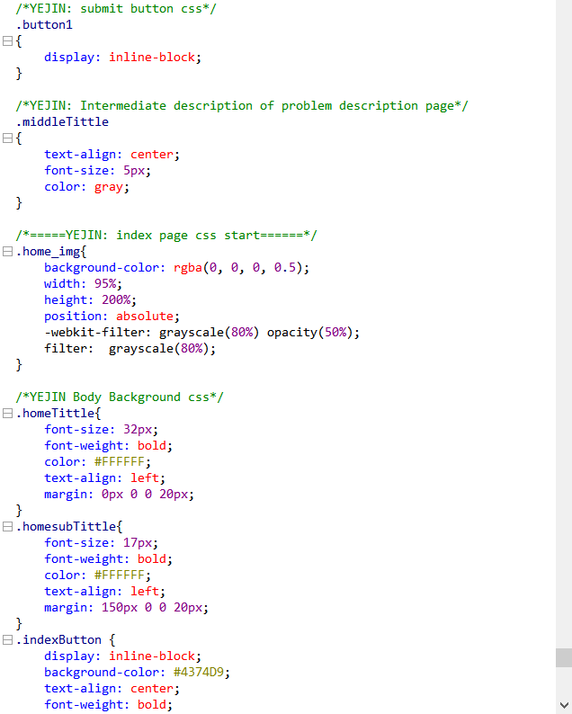
05 Implementation Details
<CSS – main page>
Web programming
Team project (Group E)
Notes:
HTML, JS, CSS 3가지로 나누어서 설명하겠다.

Slide 16
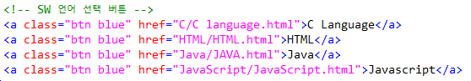
05 Implementation Details
<Top>
C Language
HTML
Java
Javascript
Home button
It is always fixed at the top.
So it is easier and faster to move between problems.
Web programming
Team project (Group E)
Notes:
HTML, JS, CSS 3가지로 나누어서 설명하겠다.

Slide 17
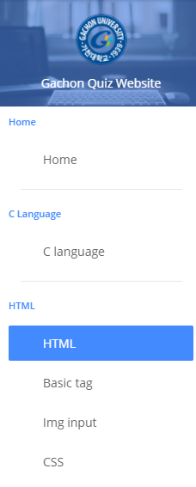
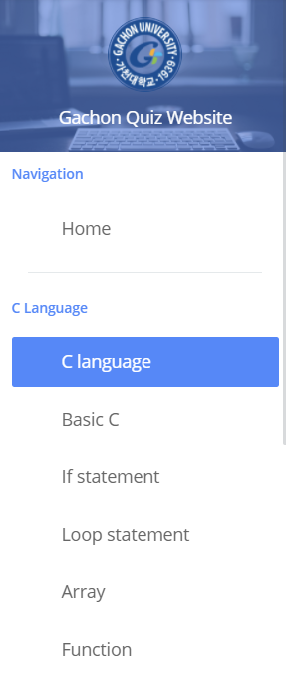
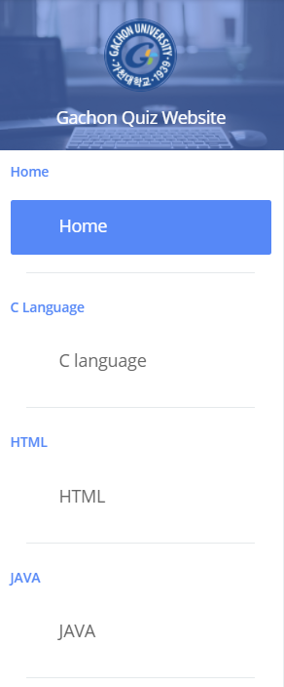
05 Implementation Details
<navigator>
When you choose a language, you see a submenu.
Summary note
Show which page it is on in blue to the Navigator
Quiz
Navigator in main page
Navigator in HTML page
Navigator in C page
Web programming
Team project (Group E)
Notes:
HTML, JS, CSS 3가지로 나누어서 설명하겠다.

Slide 18
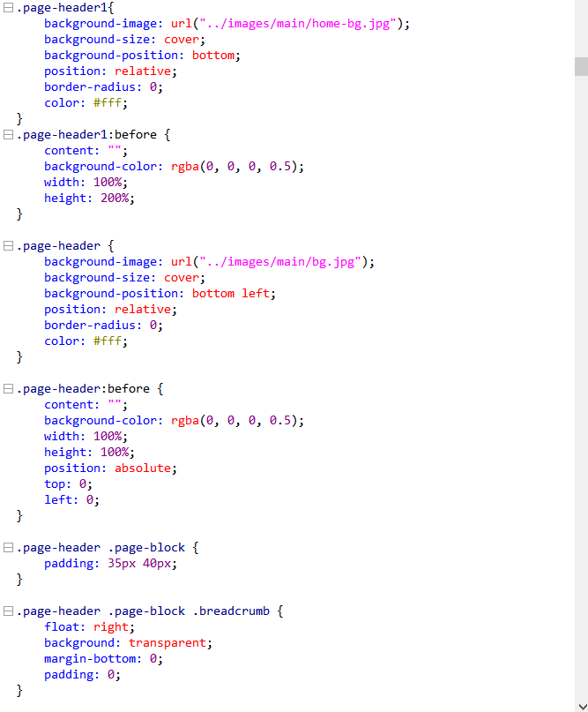
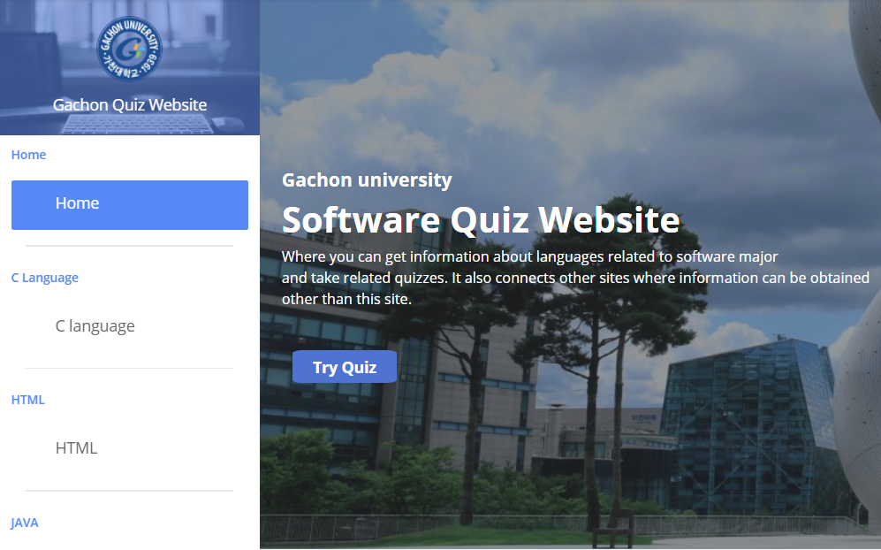
05 Implementation Details
<CSS>
Web programming
Team project (Group E)
Notes:
HTML, JS, CSS 3가지로 나누어서 설명하겠다.

Slide 19
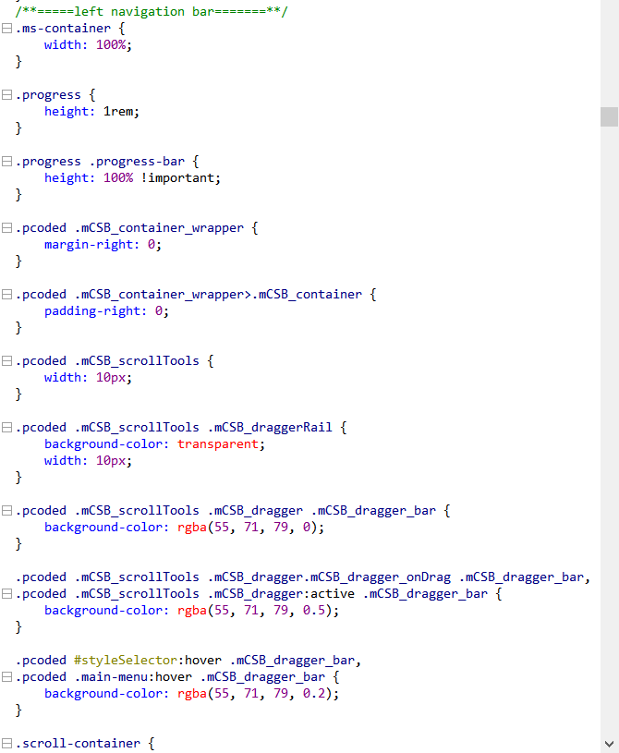
05 Implementation Details
<CSS>
Web programming
Team project (Group E)
Notes:
HTML, JS, CSS 3가지로 나누어서 설명하겠다.

Slide 20
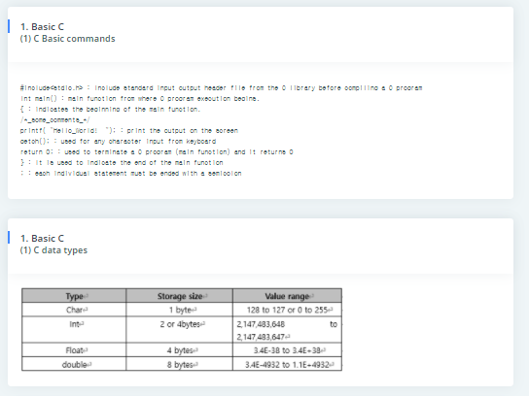
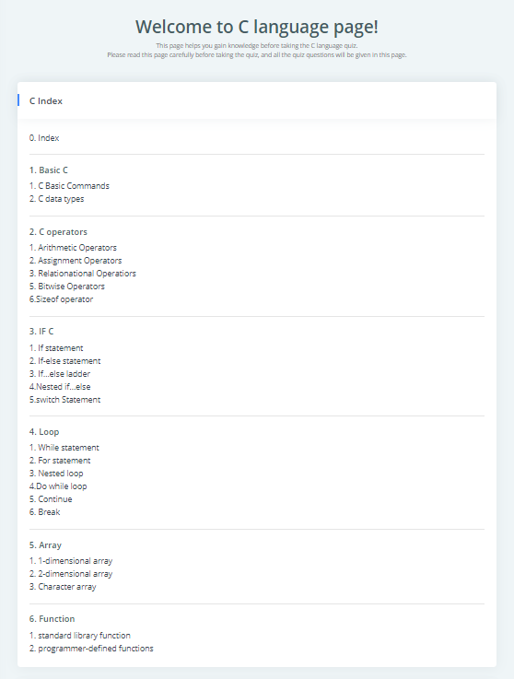
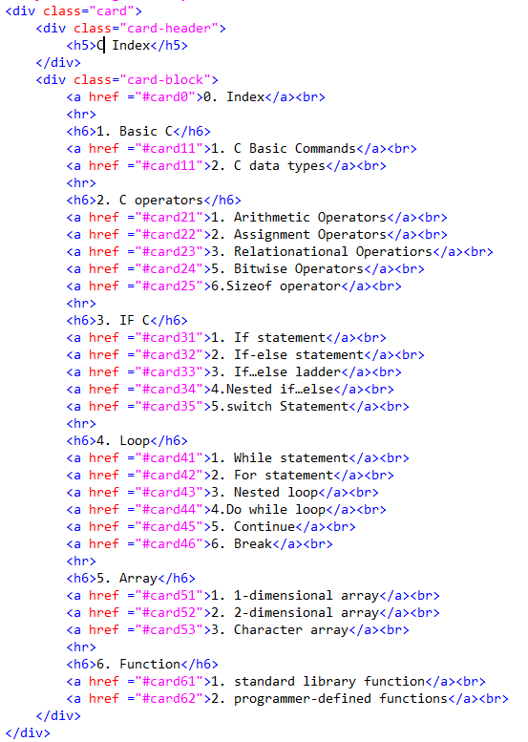
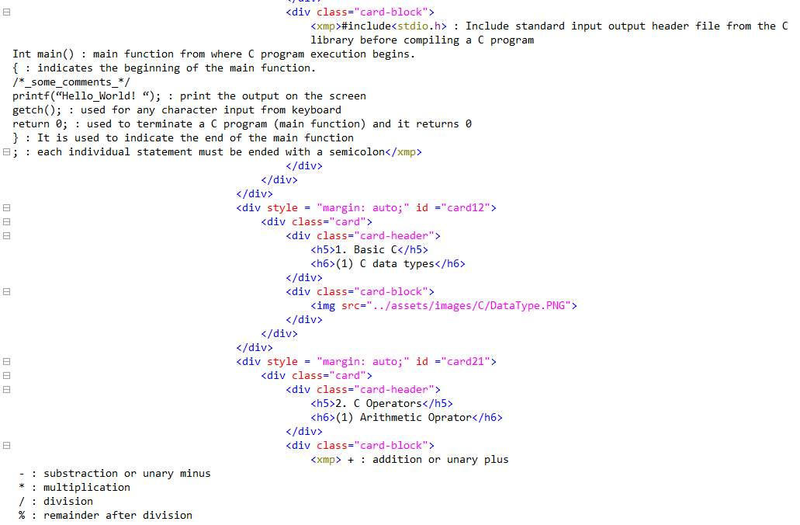
05 Implementation Details
<Theory page>
Click
Each subtitle has separate id, so move easily.
Index
Web programming
Team project (Group E)
Notes:
HTML, JS, CSS 3가지로 나누어서 설명하겠다.

Slide 21
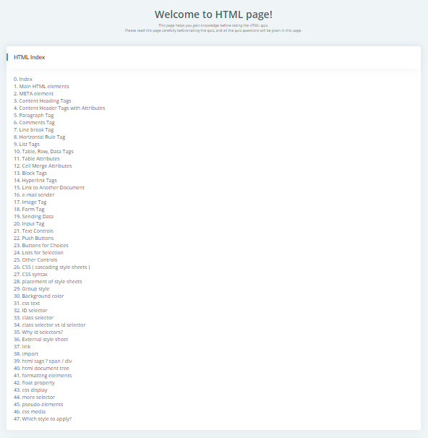
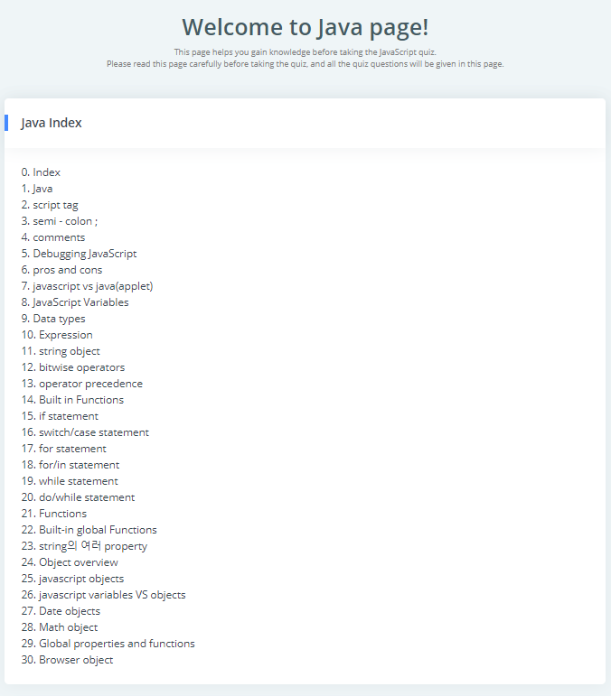
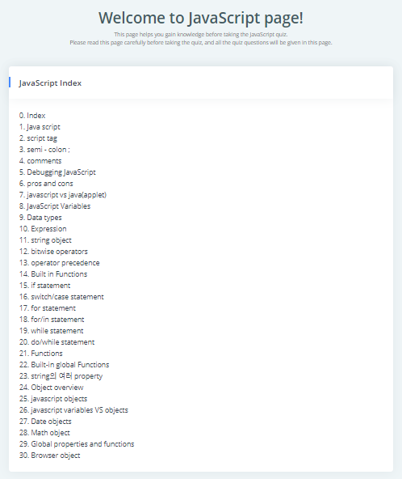
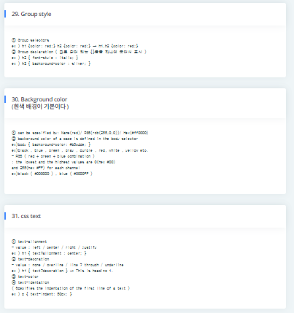
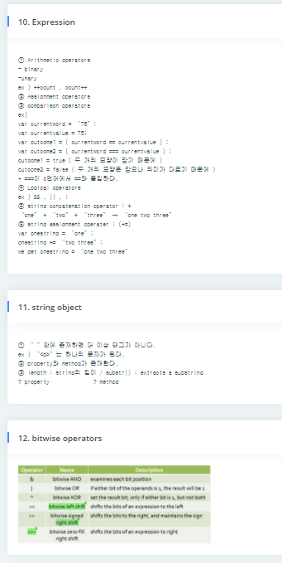
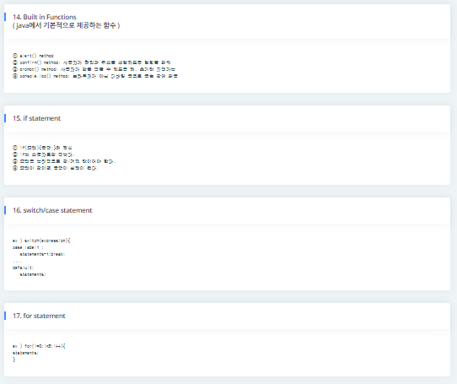
05 Implementation Details
<Theory page>
All theories about C, HTML, JavaScript, and Java are organized to help learn effectively.
Web programming
Team project (Group E)
Notes:
HTML, JS, CSS 3가지로 나누어서 설명하겠다.

Slide 22
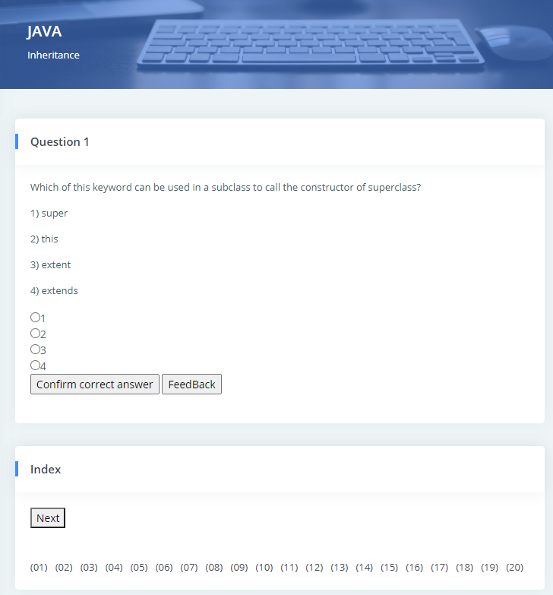
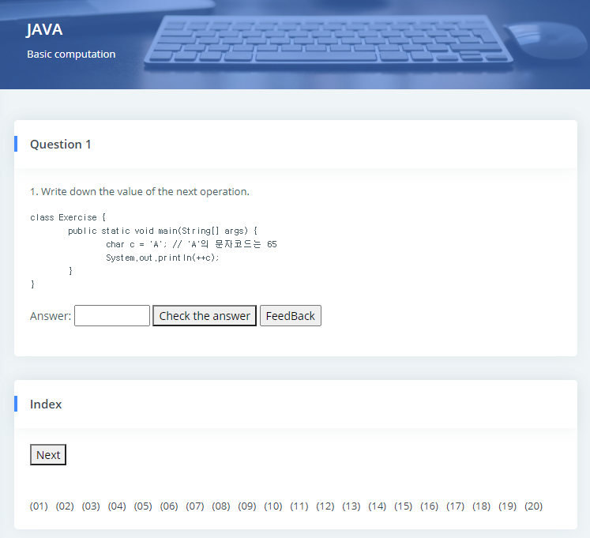
05 Implementation Details
<Quiz>
Short answer quiz
Multiple choice quiz
Button
Full quiz indez
Web programming
Team project (Group E)
Notes:
HTML, JS, CSS 3가지로 나누어서 설명하겠다.

Slide 23
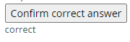
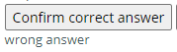
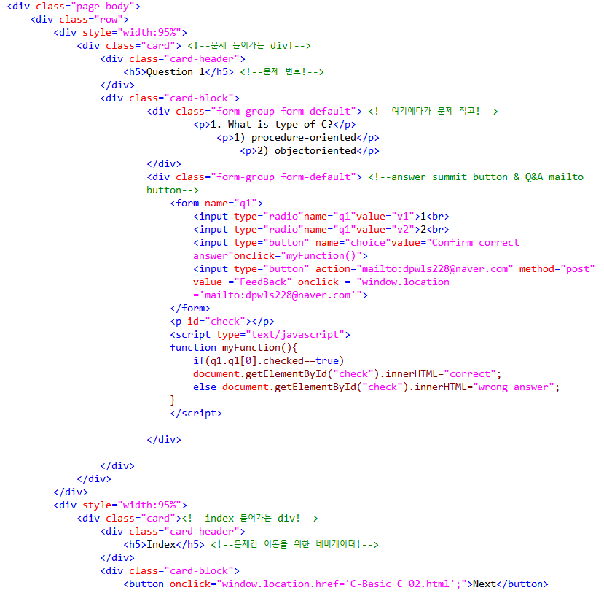
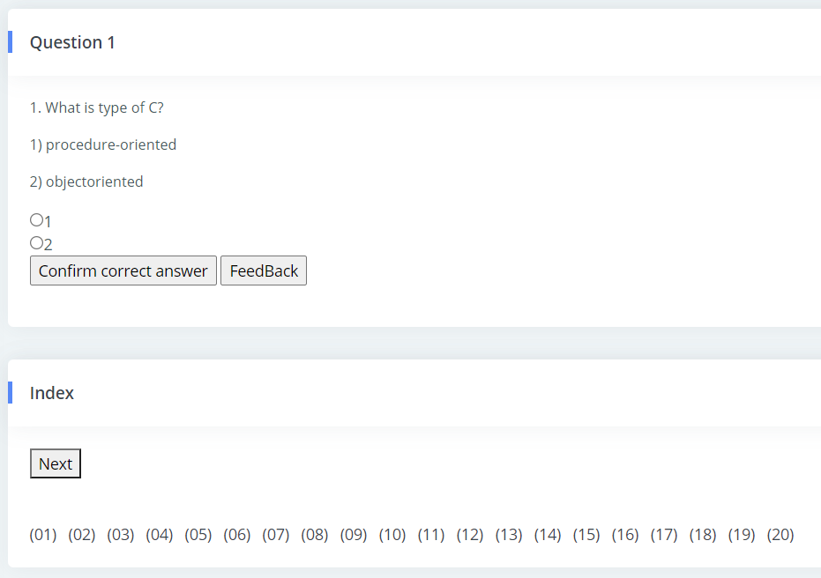
05 Implementation Details
<Quiz – multiple choice question>
Right answer
Wrong answer
Web programming
Team project (Group E)
Notes:
HTML, JS, CSS 3가지로 나누어서 설명하겠다.

Slide 24
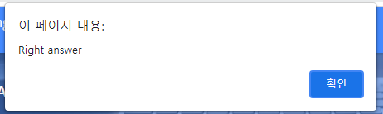
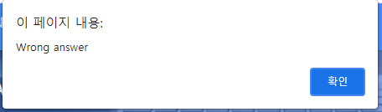
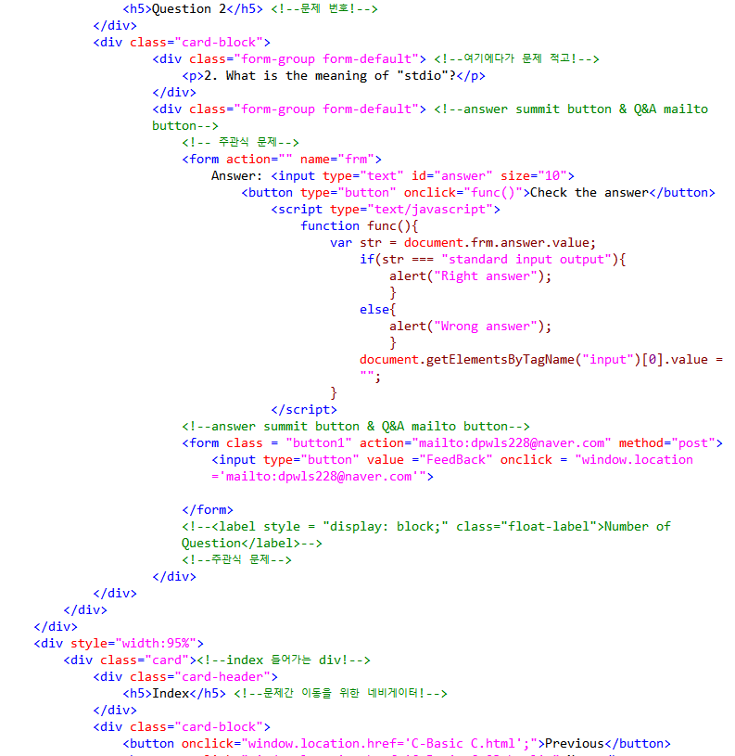
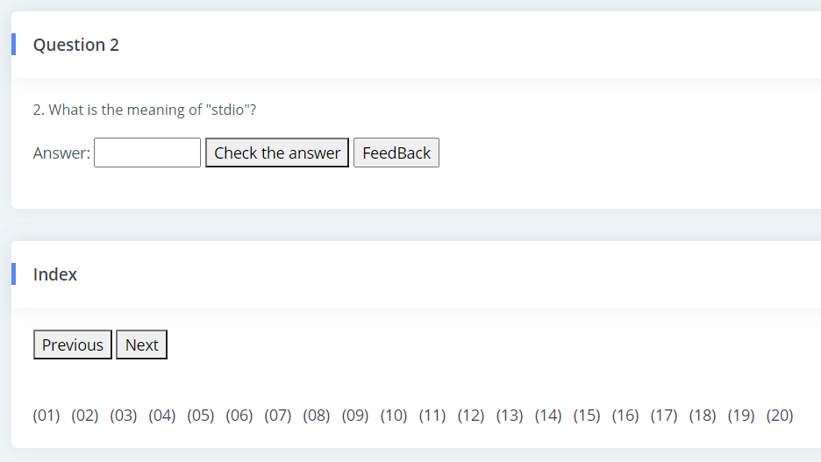
05 Implementation Details
<Quiz – short answer question>
Web programming
Team project (Group E)
Notes:
HTML, JS, CSS 3가지로 나누어서 설명하겠다.

Slide 25
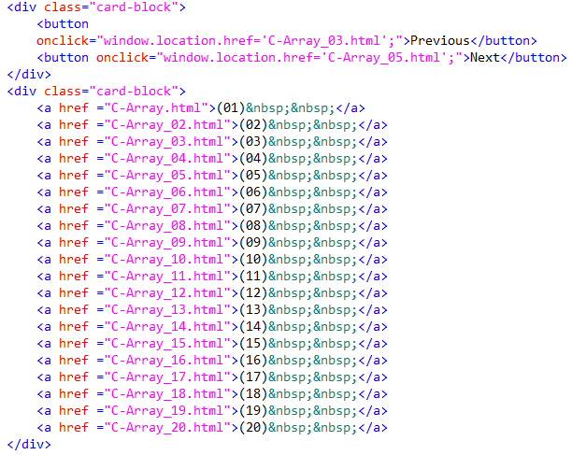
05 Implementation Details
<Quiz – index>
Can move to right before or after quiz
Also can move to all questions without caring sequence
Web programming
Team project (Group E)
Notes:
HTML, JS, CSS 3가지로 나누어서 설명하겠다.

Slide 26
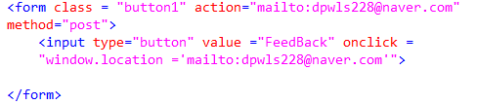
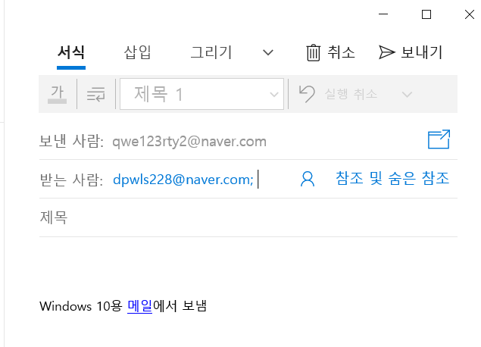
05 Implementation Details
<Quiz – feedback>
Each problem has a feedback button to talk about improvements and mistakes.
Web programming
Team project (Group E)
Notes:
HTML, JS, CSS 3가지로 나누어서 설명하겠다.

Slide 27
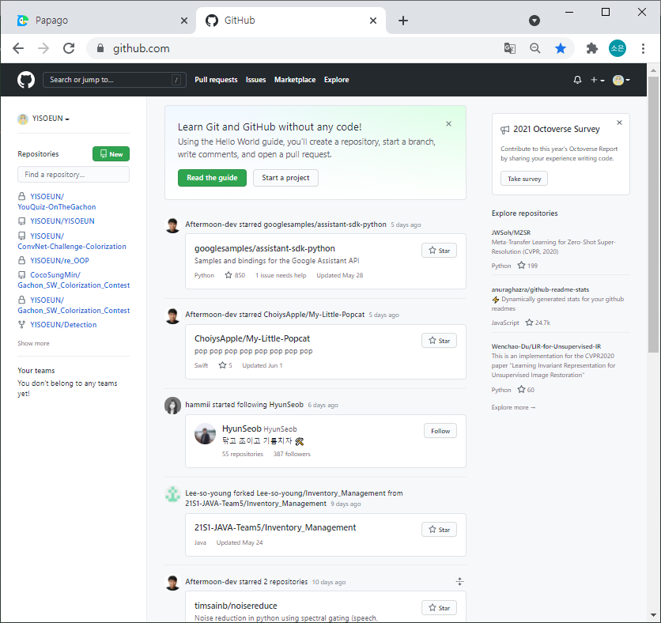
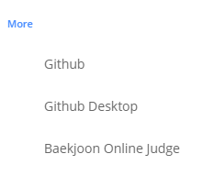
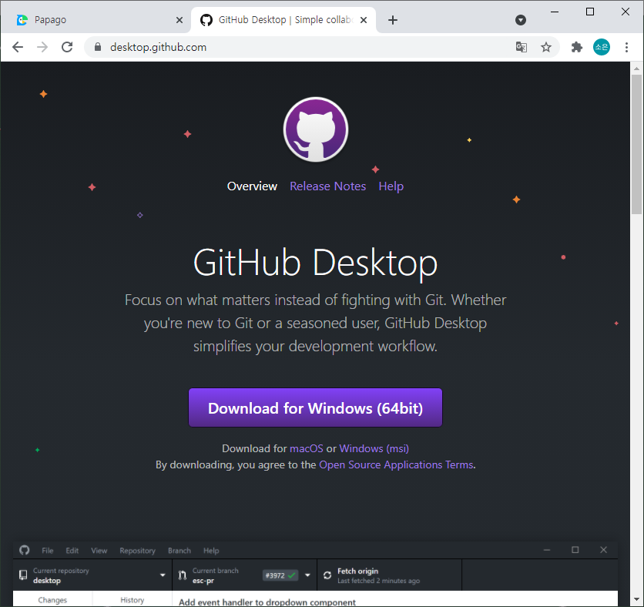
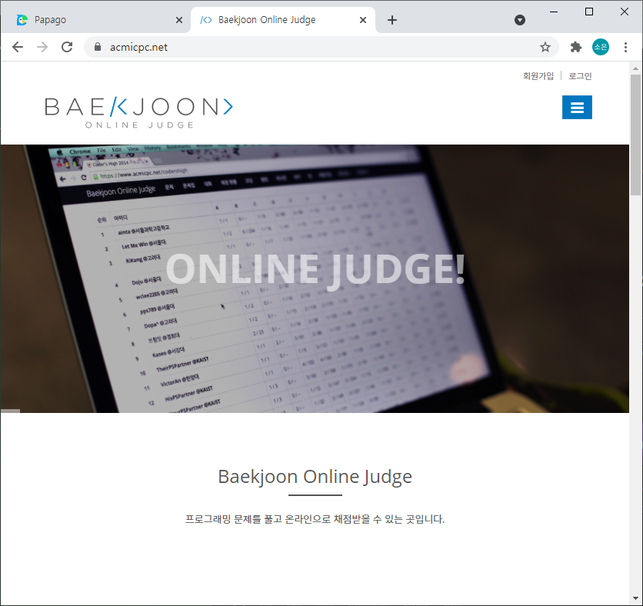
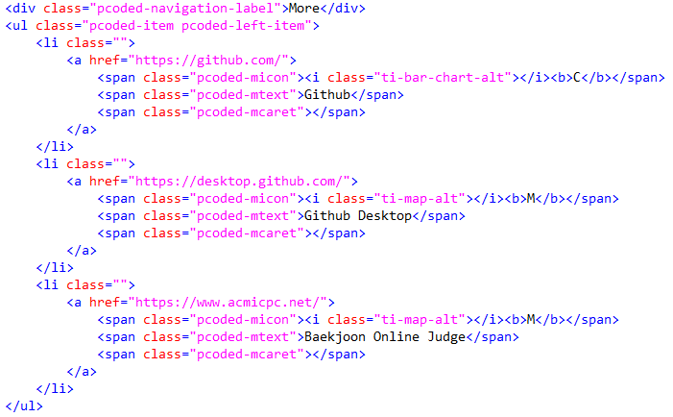
05 Implementation Details
<More – github, github desktop, baekjoon>
Web programming
Team project (Group E)
Notes:
HTML, JS, CSS 3가지로 나누어서 설명하겠다.

Slide 28
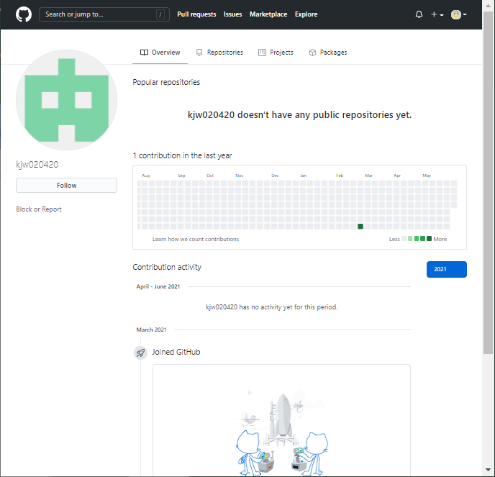
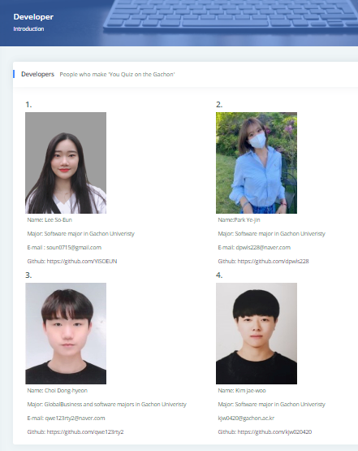
05 Implementation Details
<Developer – information>
Another development status of developers can be identified.
Web programming
Team project (Group E)
Notes:
HTML, JS, CSS 3가지로 나누어서 설명하겠다.

Slide 29
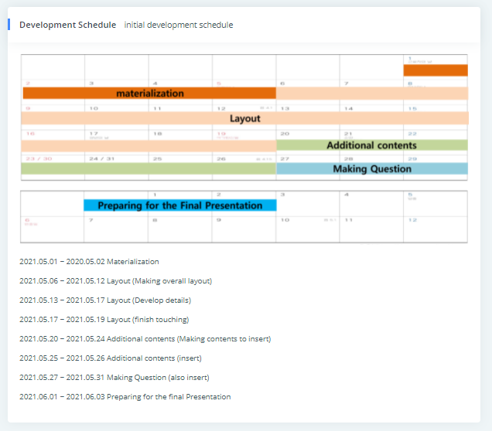
05 Implementation Details
<Developer –schedule>
Can see about the development schedule.
Furthermore, when feedback or updates are made later, users can check the version of the web page.
Web programming
Team project (Group E)
Notes:
HTML, JS, CSS 3가지로 나누어서 설명하겠다.

Slide 30
06 Expected Effect
Theory, practice, and additional study can be done at once, which can provide high efficiency.
In online teaching situations, it can be a more efficient way of learning for students.
You Quiz?
Yes!
Test what you've learned right away, and I know which unit I'm lacking and I can reinforce it.
The mobility of convenient external coding sites can broaden the field of study and create interest.
Web programming
Team project (Group E)
Notes:
HTML, JS, CSS 3가지로 나누어서 설명하겠다.

Slide 31
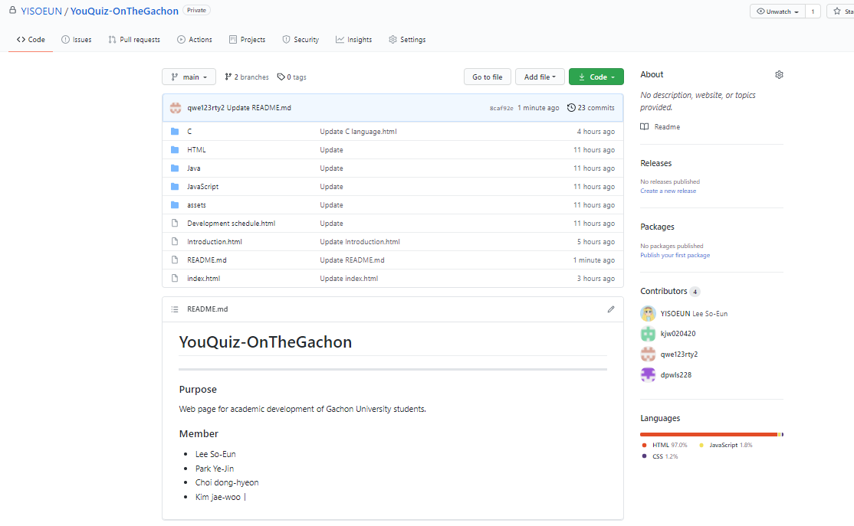
07 information
<Github>
-https://github.com/YISOEUN/YouQuiz-OnTheGachon.git
Web programming
Team project (Group E)
Notes:
HTML, JS, CSS 3가지로 나누어서 설명하겠다.

Slide 32
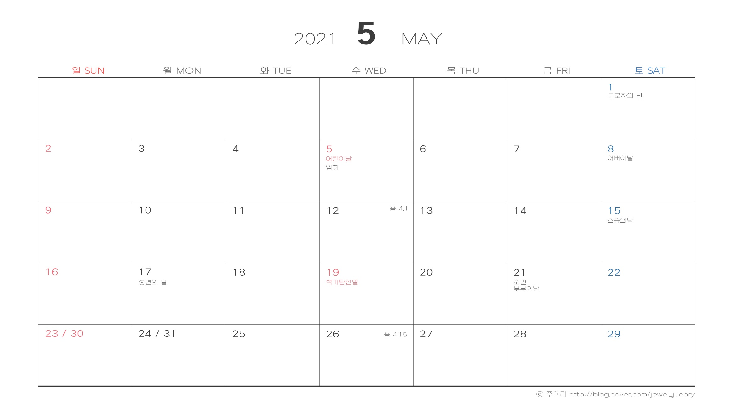


07 information
<Develop Schecule>
materialization
Layout
Additional contents
Making Question
Preparing for the Final Presentation
Web programming
Team project (Group E)
Notes:
HTML, JS, CSS 3가지로 나누어서 설명하겠다.

Slide 33

07 information
<Member>
Kim jae-woo
kjw0420@gachon.ac.kr
Park Ye-jin
dpwls228@naver.com
Lee So-Eun
soun0715@gmail.com
Choi Dong-hyeon
qwe123rty2@naver.com
Web programming
Team project (Group E)
Notes:
HTML, JS, CSS 3가지로 나누어서 설명하겠다.

Slide 34
07 information
<Duty Division>
Kim jae-woo
Making C questions
Layout
Navigator
C theory content
More section
Park Ye-jin
Making HTML Question
Layout
Top section
Main page
Java theory
Lee So-Eun
Making Java Question
Layout
Making PPT
Developer
C, HTML theory
Choi Dong-hyeon
Making HTML questions
Top section
Layout
C theory content
Web programming
Team project (Group E)
Notes:
HTML, JS, CSS 3가지로 나누어서 설명하겠다.

Slide 35




THANK YOU
Web programming
Team project (Group E)

Slide 36
Any Question?
Web programming
Team project (Group E)

